Slide 1

Algebra 1
Unit 1, Lesson 8 Equivalent Radical Expressions Volume 1, pg. 40

Slide 2


Benchmark
MA.912.NSO.1.4
Apply previous understanding of operations with rational numbers to add, subtract, multiply, and divide numerical radicals.
volume 1, pg. 40

Slide 3
Integrated Mathematical Thinking and Reasoning Standards
MA.K12.MTR.1.1 Actively participate in effortful learning both individually and collectively.
MA.K12.MTR.3.1 Complete tasks with mathematical fluency.
volume 1, pg. 40

Slide 4

Learning Targets
I can relate the power of a product law of exponents to the product law of radicals.
Given a numerical radical, I can use the product law of radicals to write an equivalent numerical radical.
volume 1, pg. 40

Slide 5

Warm-Up
volume 1, pg. 40

Slide 6
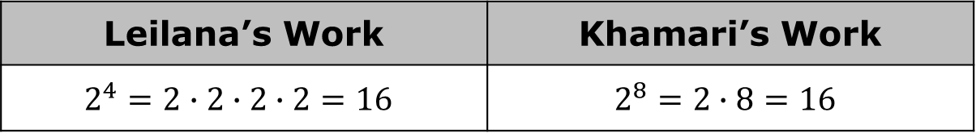
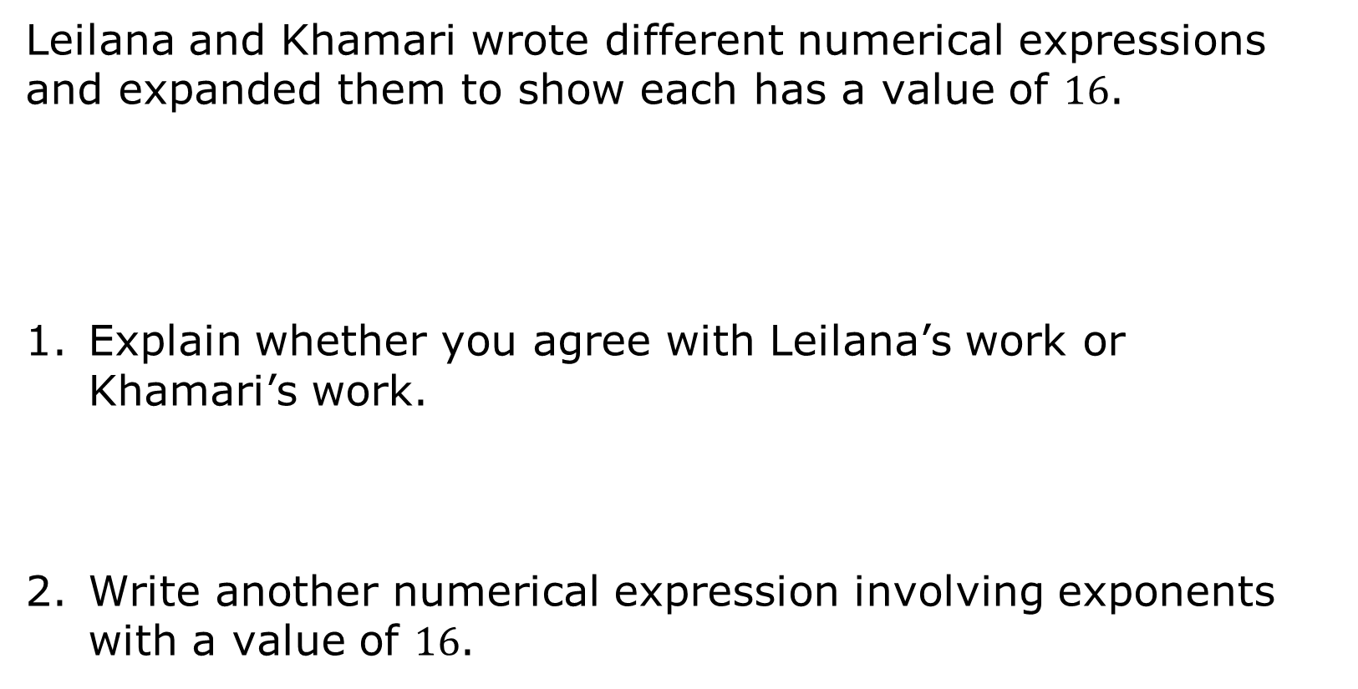
1.8.1 Warm-Up: Error Analysis
Leilana and Khamari wrote different numerical expressions and expanded them to show each has a value of $16$.
Explain whether you agree with Leilana’s work or Khamari’s work.
Write another numerical expression involving exponents with a value of $16$.
Leilana’s Work | Khamari’s Work
$$2^{4}=2∙2∙2∙2=16$$ | $$2^{8}=2∙8=16$$
volume 1, pg. 40
Notes:
Video Link: https://algebranation.wistia.com/medias/fi4fidi5y8

Slide 7

Exploration
volume 1, pg. 41

Slide 8


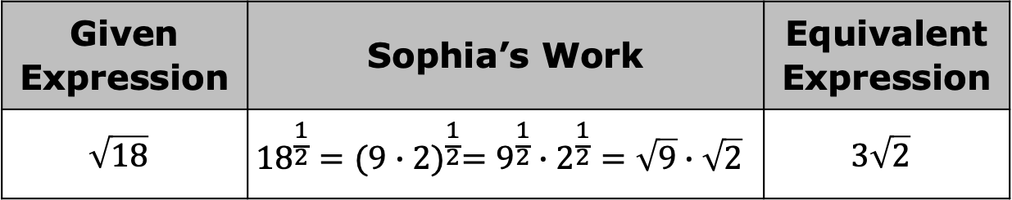
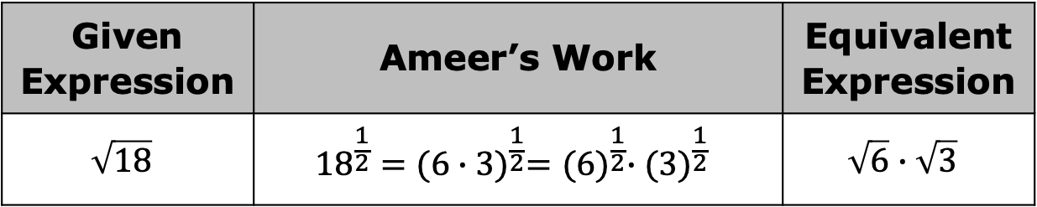
1.8.2 Exploration: Equivalent Radical Expressions
Ameer was asked to write an equivalent expression for $\sqrt{18}$. His work and resulting expression are shown.
Sophia wrote a different equivalent expression for $\sqrt{18}$. Her work and resulting expression are shown.
Given Expression | Ameer’s Work | Equivalent Expression
$$\sqrt{18}$$ | $${18}^{\frac{1}{2}}={(6∙3)}^{\frac{1}{2}}={(6)}^{\frac{1}{2}}∙({3)}^{\frac{1}{2}}$$ | $$\sqrt{6}∙\sqrt{3}$$
Given Expression | Sophia’s Work | Equivalent Expression
$$\sqrt{18}$$ | $${18}^{\frac{1}{2}}={(9∙2)}^{\frac{1}{2}}=9^{\frac{1}{2}}∙2^{\frac{1}{2}}=\sqrt{9}∙\sqrt{2}$$ | $$3\sqrt{2}$$
volume 1, pg. 41

Slide 9

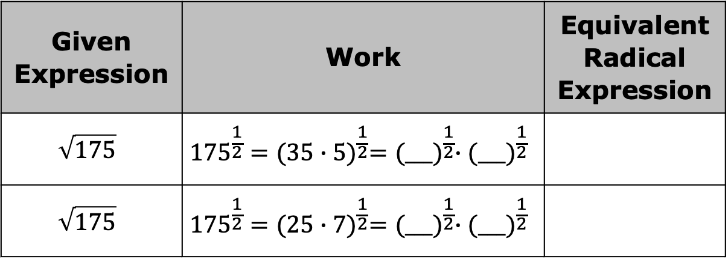
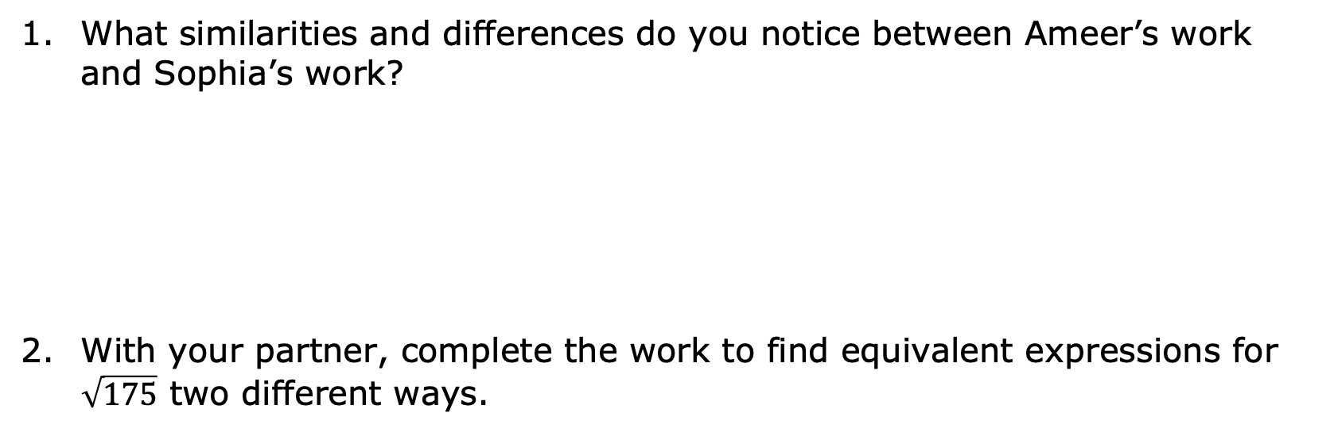
What similarities and differences do you notice between Ameer’s work and Sophia’s work?
With your partner, complete the work to find equivalent expressions for $\sqrt{175}$ two different ways.
Similarities | Differences
Given Expression | Work | Equivalent Radical Expression
$$\sqrt{175}$$ | $${175}^{\frac{1}{2}}={(35∙5)}^{\frac{1}{2}}={(___)}^{\frac{1}{2}}∙{(___)}^{\frac{1}{2}}$$
$$\sqrt{175}$$ | $${175}^{\frac{1}{2}}={(25∙7)}^{\frac{1}{2}}={(___)}^{\frac{1}{2}}∙{(___)}^{\frac{1}{2}}$$
volume 1, pg. 41

Slide 10


Which equivalent radical expression above can be rewritten in the form of an integer multiplied by a radical?
because _____ is a perfect square,
volume 1, pg. 41

Slide 11

Guided Instruction
volume 1, pg. 42

Slide 12

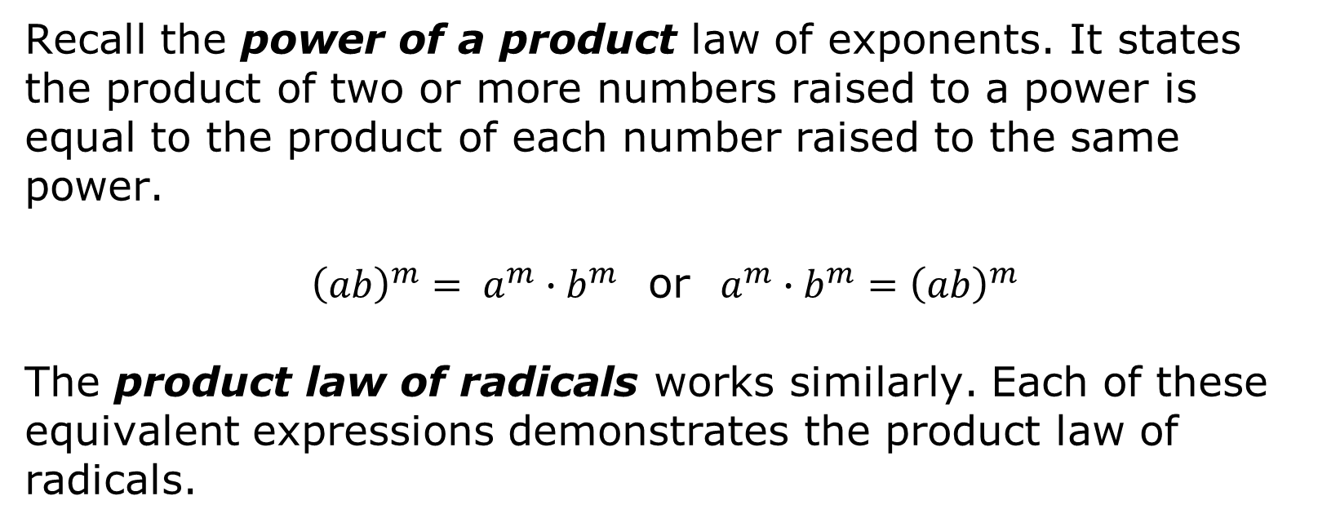
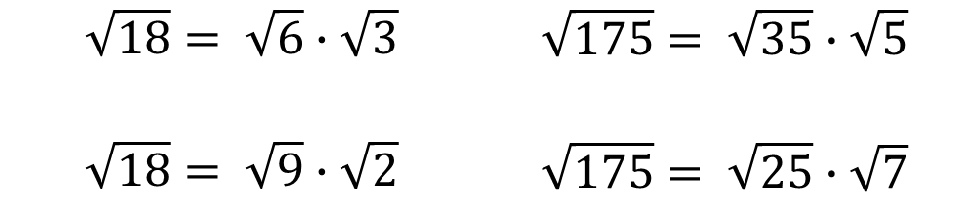
1.8.3 Guided Instruction: Equivalent Radical Expressions
Recall the power of a product law of exponents. It states the product of two or more numbers raised to a power is equal to the product of each number raised to the same power.
${\left(ab\right)}^{m}= a^{m}∙b^{m}$ or $a^{m}∙b^{m}={\left(ab\right)}^{m}$
The product law of radicals works similarly. Each of these equivalent expressions demonstrates the product law of radicals.
$$\sqrt{18}= \sqrt{6}∙\sqrt{3}$$ $$\sqrt{18}= \sqrt{9}∙\sqrt{2}$$ | $$\sqrt{175}= \sqrt{35}∙\sqrt{5}$$ $$\sqrt{175}= \sqrt{25}∙\sqrt{7}$$
volume 1, pg. 42

Slide 13
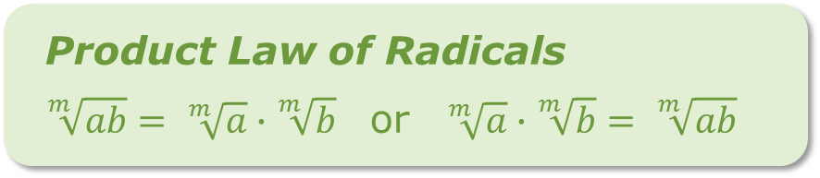
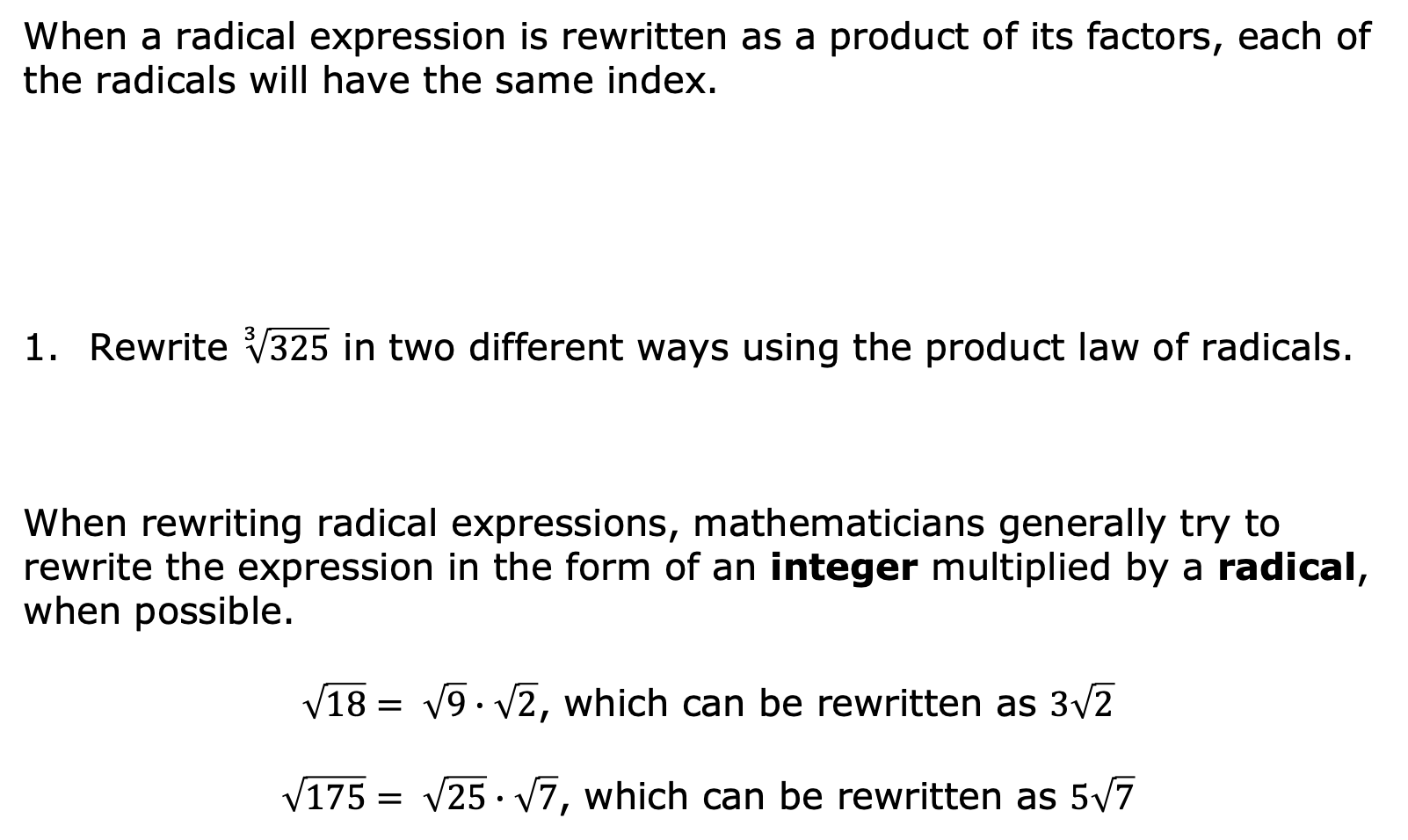
When a radical expression is rewritten as a product of its factors, each of the radicals will have the same index.
Rewrite $\sqrt[3]{325}$ in two different ways using the product law of radicals.
When rewriting radical expressions, mathematicians generally try to rewrite the expression in the form of an integer multiplied by a radical, when possible.
$\sqrt{18}= \sqrt{9}∙\sqrt{2}$, which can be rewritten as $3\sqrt{2}$
$\sqrt{175}= \sqrt{25}∙\sqrt{7}$, which can be rewritten as $5\sqrt{7}$
Product Law of Radicals
$\sqrt[m]{ab}= \sqrt[m]{a}∙\sqrt[m]{b}$ or $\sqrt[m]{a}∙\sqrt[m]{b}= \sqrt[m]{ab}$
volume 1, pg. 42

Slide 14
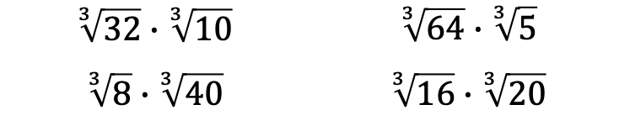
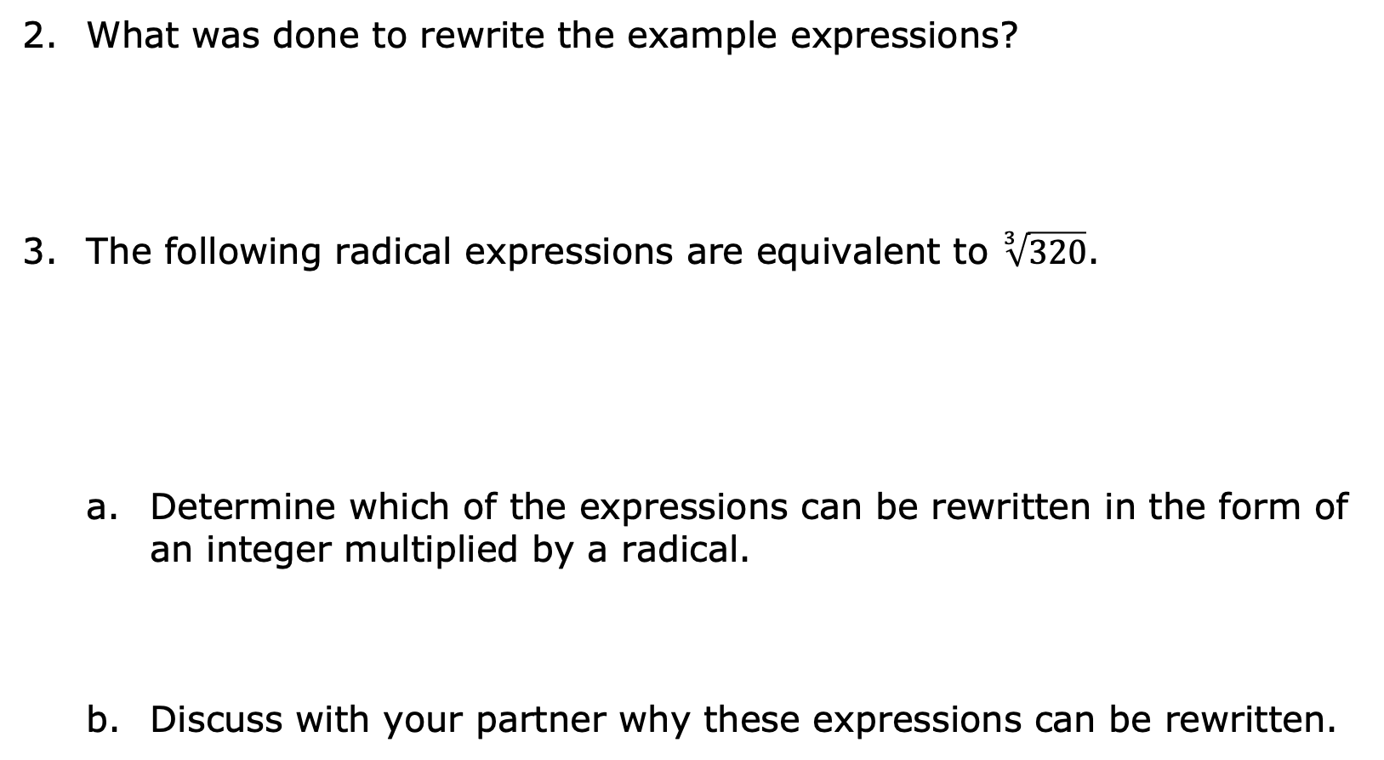
What was done to rewrite the example expressions?
The following radical expressions are equivalent to $\sqrt[3]{320}$.
Determine which of the expressions can be rewritten in the form of an integer multiplied by a radical.
Discuss with your partner why these expressions can be rewritten.
$$\sqrt[3]{32}∙\sqrt[3]{10}$$ | $$\sqrt[3]{64}∙\sqrt[3]{5}$$
$$\sqrt[3]{8}∙\sqrt[3]{40}$$ | $$\sqrt[3]{16}∙\sqrt[3]{20}$$
volume 1, pg. 42

Slide 15
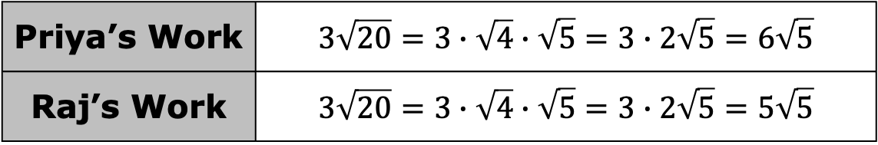
Some radical expressions are given as an integer multiplied by the radical before any rewriting is done. Priya and Raj were asked to rewrite this type of expression. Their work is shown.
Explain whether Priya or Raj rewrote the expression correctly.
Priya’s Work | $$3\sqrt{20}=3∙\sqrt{4}∙\sqrt{5}=3∙2\sqrt{5}=6\sqrt{5}$$
Raj’s Work | $$3\sqrt{20}=3∙\sqrt{4}∙\sqrt{5}=3∙2\sqrt{5}=5\sqrt{5}$$
volume 1, pg. 43

Slide 16

Try It
volume 1, pg. 43

Slide 17
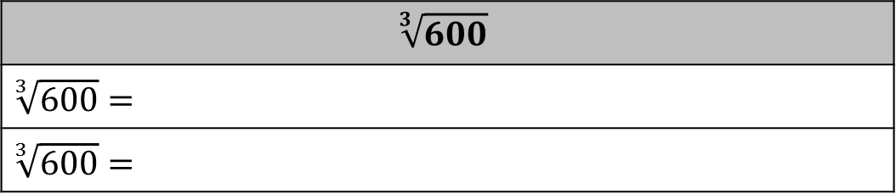
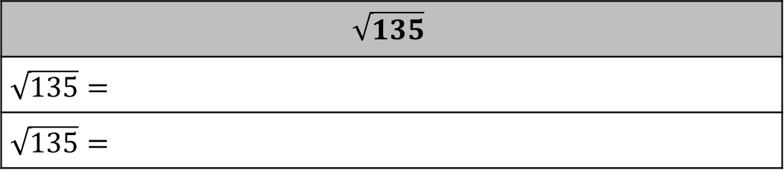
1.8.4 Try It: Equivalent Radical Expressions
Write two equivalent expressions for each radical expression. Show all your steps.
$$\sqrt{135}$$
$\sqrt{135}=$
$\sqrt{135}=$
$$\sqrt[3]{600}$$
$\sqrt[3]{600}=$
$\sqrt[3]{600}=$
volume 1, pg. 43

Slide 18
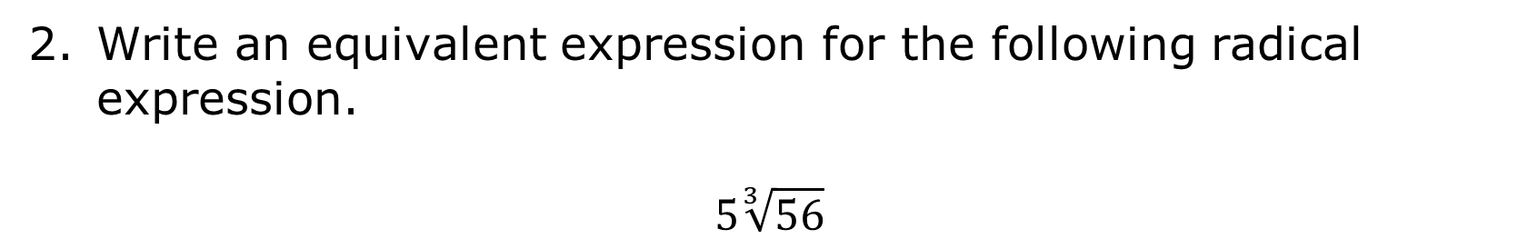
Write an equivalent expression for the following radical expression.
$$5\sqrt[3]{56}$$
volume 1, pg. 43

Slide 19

Your Turn
volume 1, pg. 44

Slide 20


1.8.5 Your Turn!
Select all expressions that are equivalent to $\sqrt{40}$.
${(40)}^{\frac{1}{2}}$
$2\sqrt{20}$
$\sqrt{4}∙\sqrt{10}$
${(20∙2)}^{\frac{1}{2}}$
$5\sqrt{8}$
$2\sqrt{10}$
${(10∙4)}^{\frac{1}{2}}$
volume 1, pg. 44

Slide 21
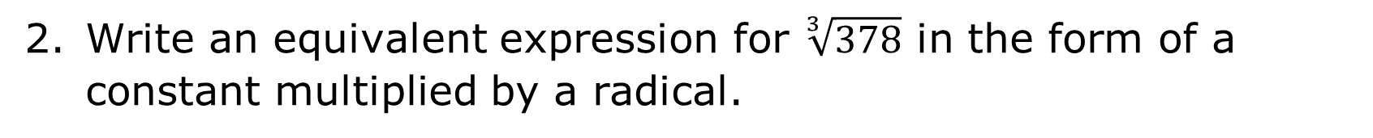
Write an equivalent expression for $\sqrt[3]{378}$ in the form of a constant multiplied by a radical.
volume 1, pg. 44

Slide 22

Wrap-Up
volume 1, pg. 44

Slide 23

1.8.6 Wrap-Up: Reflection
What was the muddiest (most difficult or confusing) point in today’s lesson on writing equivalent expressions for numerical radicals?
volume 1, pg. 44

